Slide 1


Environment management
Running Python Options

Slide 2
Environment management
Why
Environment manager available: conda, mamba, pyvenv
How it works
Demo

Slide 3





Environment management Why

Slide 4
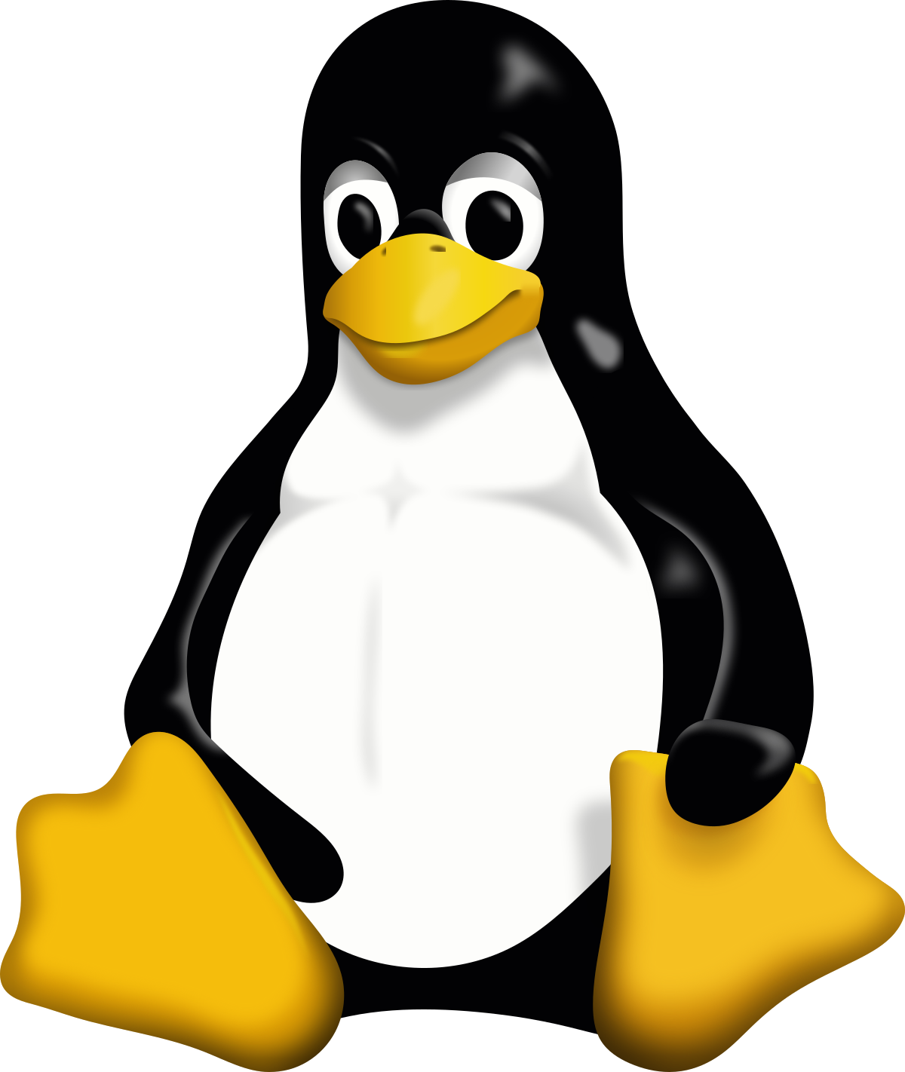


Environment management Why & How
myEnv1
Python 3.7
Matplotlib 3.7.2
Numpy 1.25.2
py310
Python 3.10
Matplotlib 3.6.0
Scipy 1.11.1
Pyqtgraph 1.13
Pandas 2.03
Qt 5.0
Environment
manager
p311
$ conda remove –name p311 --all
Python 3.11
Pandas 2.02
Qt 5.0

Slide 5
Environment management Why & How
myEnv1
Python 3.7
Matplotlib 3.7.2
Numpy 1.25.2
py310
Python 3.10
Matplotlib 3.6.0
Scipy 1.11.1
Pyqtgraph 1.13
Pandas 2.03
Qt 5.0
Environment
manager
p311
$ conda create –n env311 python=3.11 pandas=2.02 qt=5.0
Python 3.11
Pandas 2.02
Qt 5.0

Slide 6
Environment management Demo
Plan:
Create a conda environment called py38 that has the following requirements:
Python 3.8
Matplotlib (latest version)
Numpy (latest version)
Activate the environment
Install jupyter
Let’s jump to a terminal …

Slide 7
Environment management basic commands
$ conda env list
$ conda activate <environment name>
$ conda deactivate <environment name>
$ conda remove –n <environment name> --all

Slide 8
Running python options
Python terminal (iTerm, warp …)
Ipython
Notebook (anaconda navigator, jupyter lab, jupyter notebook)
Editor + command line (emacs, brackets, Atoms, …)
IDE (PyCharm, Visual Studio, Eclipse, …)

Slide 9
Running python options
Python terminal (iTerm, warp …) – to try a command
Ipython – to try a command
Notebook (anaconda navigator, jupyter lab, jupyter notebook)
to test a routine, to play with data, to give a script to others, to learn python
Editor + command line (emacs, brackets, Atoms, …)
to create batch scripts
IDE (PyCharm, Visual Studio, Eclipse, …)
to implement long term-use programs, to create libraries

